Slide 1
FRESHERS TRAINING
Program Execution
OS
Day Incharge : Seshagopalan
Session Handler : Lucky Tyagi
(lucky.j@e-consystems.com)
INTRODUCTION
TO
Cross
Compile
Linux
Commands
GCC
Compiler
Vim
Sample
C Code

Slide 2
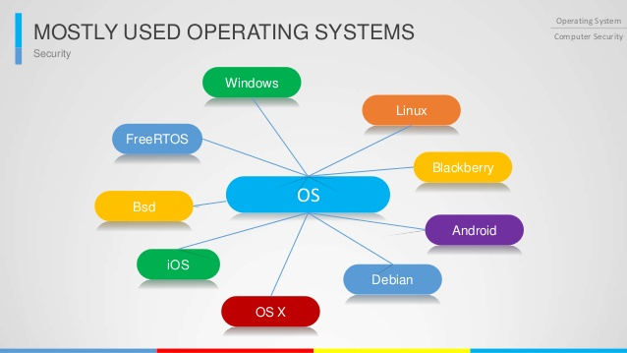
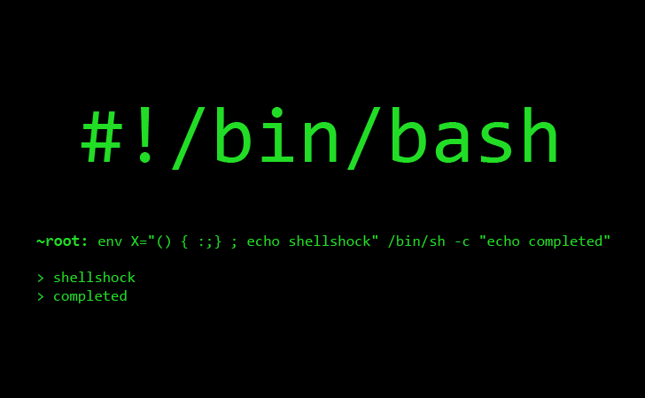
Operating System
What is it ?
What does it do ?
Types
Linux - OS
Boot Process of Linux System
Workstation
Embedded System
Linux Commands
Terminal Vs. Console
tty1 - tty7
Shell
Sample Commands
Shell Script
Sample Shell Script

Slide 3


Vim Usage
What is it ?
What does it do ?
Create and save a file
Customization
Local
Global
Navigation Shortcuts
GCC Compiler
What is it ?
What does it do ?
Compilation Stages
Debug info
Sample examples
Compiling a C code
Verbose output discussion

Slide 4
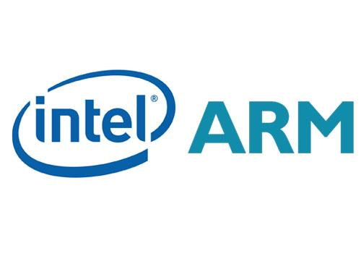
Cross-Compilation
What is it ?
Why is it needed ?
How it works ?
How to use it ?
Open Discussion
How a program runs on a
processor ?

Slide 5
Operating System

Slide 6
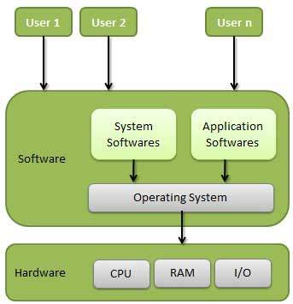
An operating system is a program that acts as an interface between the user and the computer hardware and controls the execution of all kinds of programs.
Important functions of an OS :
Memory Management
Processor Management
Device Management
File Management
Coordination between other software and users
etc.
Types of OS :
Batch Operating System
Time-Sharing Operating System
Distributed Operating System
Network Operating System
Real Time Operating System

Slide 7
Linux OS
Components of Linux OS :
Bootloader
Manages the boot process of your computer.
Kernel
Kernel is the core part of Linux.
Responsible for all major activities.
Interacts directly with the underlying hardware.
System Library
Special functions or programs using which application programs or system utilities accesses Kernel's features.
Daemons
Background services (printing, sound, scheduling, etc) that either start up during boot, or after you log into the desktop.

Slide 8
Linux Boot-Up Process

Slide 9






Linux Workstation

Slide 10
Embedded Linux

